Slide 1


A Deep Learning Approach for Predicting miRNA-RRE Interactions and Quantifying Competitive Effects
A Novel Regression Model for Ranking Therapeutic miRNA Candidates Against HIV
Abdullah Al Marzan
August 23, 2025

Slide 2
Introduction - The Problem
The Challenge: HIV remains a global health issue.
The HIV Rev-RRE Axis: Critical for viral replication.
Therapeutic Avenue: Disrupting Rev-RRE interaction is a promising strategy.

Slide 3
Our Proposed Solution
Objective: Develop a deep learning model to predict miRNA-RRE binding affinity.
Key Innovations:
- Regression-based prediction
- Explicit competition modeling
- Multi-modal data integration

Slide 4
Methodology - Overall Workflow
Workflow:
1. Data Curation
2. Dataset Generation
3. Model Training
4. Prediction & Ranking

Slide 5
Methodology - Data Sourcing
miRNA Dataset: ~1,00,000 miRNAs
Target (RRE): Known variants (100)
Competitor (REV): Sequences(100)
Ground Truth: Experimental affinity scores
Supporting Data: Conservation scores

Slide 6
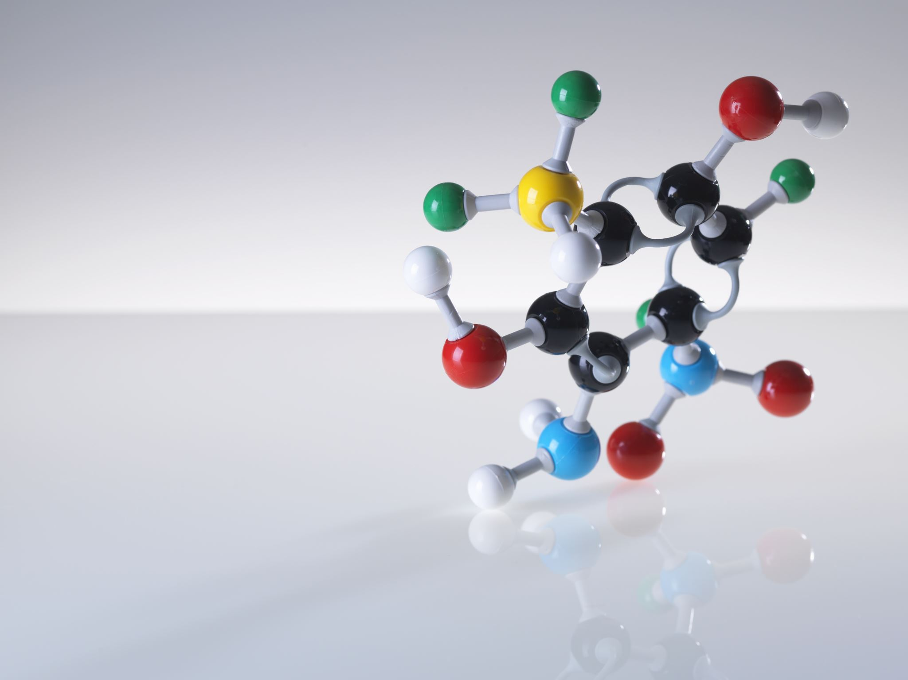
Methodology - Feature Engineering
Features:
- GC Content
- Secondary Structure (RNAfold)
- Minimum Free Energy (dG)
- Structural encoding as vectors

Slide 7

Methodology - The 'Augmented Pairs' Strategy
Two rows for each (miRNA + RRE):
1. Baseline (Null competitor)
2. Competition (Real REV)
Both share same ground-truth affinity.
Forces model to learn competition impact.

Slide 8

Methodology - Data Preprocessing for DL
Steps:
- One-hot encoding
- Padding to uniform length
- MinMax scaling of numerical features
- 80/20 train-test split
Dataset size: >3M rows

Slide 9

Methodology - Model Architecture
Multi-input CNN:
- Branches for miRNA, RRE, REV, structure, numerical features
- 1D CNN for sequences
- Dense for numerical
- Concatenation → Dense layers for regression

Slide 10

Methodology - Model Training (Regression)
Task: Regression (fractional affinity score)
Loss: Mean Squared Error (MSE)
Callbacks:
- EarlyStopping
- ModelCheckpoint
- ReduceLROnPlateau

Slide 11

Results - Training Performance
Consistent decrease in training & validation loss.
EarlyStopping prevented overfitting.
Model achieved stable convergence.

Slide 12
Results - Model Accuracy
Evaluation:
- Scatter plot of Predicted vs Actual scores
- Strong positive correlation
- R² = [Insert Value]

Slide 13
Results - Ranking New miRNAs
Used trained model to rank novel candidates.
Output: Ranked list of miRNAs based on affinity in presence of REV.

Slide 14
Results - Quantifying Competitive Effect
Competitive Effect Score = (Affinity w/o REV) - (Affinity with REV)
Higher score = Stronger inhibitory effect of REV.

Slide 15

Key Findings
Findings:
- Continuous regression predictions
- Augmented Pairs effectively model REV competition
- Actionable ranked list of therapeutic candidates

Slide 16

Discussion
Nuanced regression approach vs classification.
Ability to quantify REV competition.
Limitations:
- Reliant on input data quality
- RNAfold approximates structure

Slide 17
Conclusion & Future Work
Conclusion: Created a novel DL regression tool for HIV miRNA therapeutics.
Future Work:
- Wet-lab validation
- Expansion to other viral targets
- Interpretability (e.g., SHAP)

Slide 18
Q & A
Thank You!
Questions?

